Slide 1
Gradient decent algorithm
By Shamayita Acharya

Slide 2
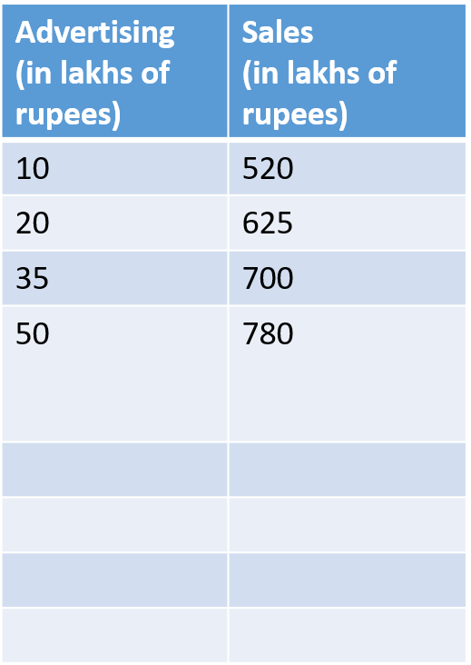
Predicting sales of an item

Slide 3
